Slide 1
Microsoft Power Automate Empowerment
Notes:
Hi, Welcome to Microsoft Power Automate Empowerment

Slide 2






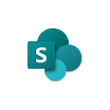





Jenkins NS
Modern Workplace Solution Architect | Consultant
Microsoft Teams, Power Platform and SPFx Specialist
International Speaker | Blogger | Trainer
SPS Bangalore Organizer
aOS Ambassador
jenkinsns@gmail.com
in/jenkinsns
@jenkinsns
http://www.jenkinsblogs.com
jenkinsns
https://www.facebook.com/spfxinfo/
https://www.facebook.com/msteamsinfo

Slide 3
Course Overview
Day 1
Empowering everyone with Power Platform
Introduction to Power Platform
Day 2
Power Automate Introduction
Microsoft Flow Basics
Day 3
Power Automate Project Scenarios
Approve / Reject Workflow Scenario
Day 4
Monitoring & Administration of Power Automate
Import, Export Flows
Microsoft Power Platform momentum
Why Power Platform?
Customer Stories
Power Platform Components Demo
Power Platform Account Setup
Microsoft Flow Templates
Decision Making with Flow
Building Workflows with Power Automate
Hands on Lab - Microsoft Flow
Conditions, Switches, Scope & Context of Decision-Making Control Elements
Recurrence Workflow Scenario
Azure Cognitive Services AI Integration Workflow Scenario
Power App Integration Workflow Scenario
SQL Server Integration Workflow Scenario
HoL - End to End Business Flow with all Scenarios
Distribute Flows
Sharing of Flows across workspaces
Different Flow Environments and Code Promotion
Data Policies & Integration Check Points
Flow History and Analytics
HoL - Check your Knowledge
UI Flows
Build and Implement Custom Connector
Errorless workflows Scenario

Slide 4
Day1: Empowering everyone with Power Platform

Slide 5

Agenda
Introduction to Power Platform
Microsoft Power Platform momentum
Why Power Platform?
Power Platform Components Demo
Customer Stories
Power Platform Account Setup

Slide 6

Notes:
It starts with how they get the most out of their business data
Data is everywhere – generated at every step of our lives
90% of world’s data generated in last 3 years alone
Everything we do, everything our customers do, everything competitors do generates some kind of data
T: In the old world, that data lived in siloes

Slide 7
Low Code Evolution

Slide 8

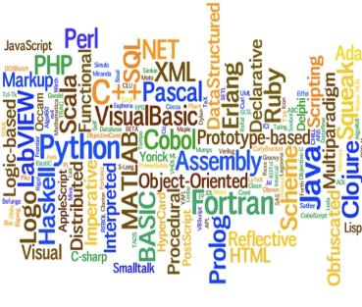


The evolution of how people buy applications
Custom Software
Packaged Software
Low-code Development
What development language do you use?
How feature rich is your software?
How agile and extensible is your platform?
ERP
CRM
HRM
ERP
CRM
HRM
Middle
-ware
MRP
Middle
-ware
PRM
MRP
PRM
MRP
OPS
LOG.
…
OPS
PRM
…

Slide 9
Benefits of low-code development platforms
Environment used to create web or mobile applications easily by mostly configurations, drop-and drops.
LOW-CODE
DEVELOPMENT PLATFORMS
Higher rate of success
Loved by both Business & IT
Breeds Innovations
Days to Weeks
Success Rate
Time to Live
Business Relevance
Innovative Culture
Traditional computer programming, writing lines of codes from scratch.
Failed projects are common
Lagging IT & constant tension with business
TRADITIONAL
DEVELOPMENT
Months to Years
Curbs Innovation

Slide 10






Who buys Power Platform?
“We need faster growth.”
“I need my teams to do a lot more with a lot less.”
CXOs
GROWTH
CFOs
EFFICACY
“We are shackled by our legacy tech. & it’s too risky to migrate!”
“Most of my employees are not desk-bound nor IT-savvy”
CIOs
INNOVATION
BDMs
ACCESSIBILITY
“So many disparate businesses with M&A, I don’t know how to start to integrate.”
“Too many manual or redundant processes because company’s IT or systems don’t work for us.”
COOs
CONSOLIDATION
Users
CITIZEN PAINS

Slide 11
Power Platform loved by businesses in all segments
Enterprise
Corporate
Midmarket
Small
Innovation platform – justify once, unlimited innovations forever
Easy first step to your digital transformation journey
Breeds unique & inclusive IT and Business innovation culture with citizen development philosophy
One Microsoft Story – MS understands business of Platforms
Company-wide digitized with easy-to-use mobile/IoT enabled applications even for frontline workers
Significantly lowered cost of automation, digitization and innovation
Fuss-less continuous innovations with citizen development capabilities
Easy to create, easy to retire, easy to change

Slide 12



Microsoft Power Platform
The low-code platform that spans Office 365, Azure, Dynamics 365, and standalone applications
Innovation anywhere. Unlocks value everywhere.
Power BI
Business analytics
Power Apps
Application development
Power Automate
Process automation
Power Virtual Agents
Intelligent virtual agents
Data connectors
Portals
AI Builder
Common Data Service

Slide 13
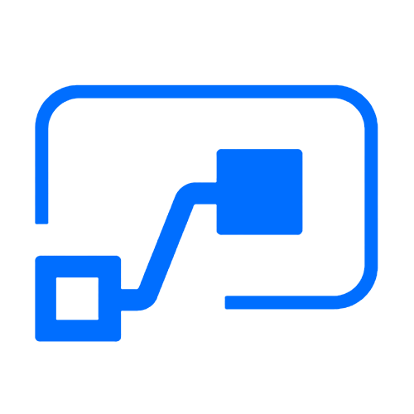

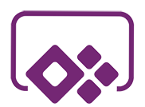

Who here has a Microsoft 365 background?
SharePoint, Teams, Exchange…
Microsoft 365
Analyze
Act
Automate
Data connectors
Power BI
Business analytics
Power Apps
Low-code/no-code application development
Power Automate
Workflow automation
Standalone apps
Common Data
Service
AI Builder

Slide 14
What about a Dynamics 365 background?
Sales, Service, Talent…
Microsoft 365
Dynamics 365
Analyze
Act
Automate
Data connectors
Power BI
Business analytics
Power Apps
Low-code/no-code application development
Power Automate
Workflow automation
Standalone apps
Common Data
Service
AI Builder

Slide 15
Last, but not least, what about Azure?
Azure SQL, Azure Functions…
Microsoft 365
Dynamics 365
Microsoft Azure
Analyze
Act
Automate
Data connectors
Power BI
Business analytics
Power Apps
Low-code/no-code application development
Power Automate
Workflow automation
Standalone apps
Common Data
Service
AI Builder

Slide 16
Why Power Platform?
Time
Resources
Cost
Data
Maintenance

Slide 17
Power Platform Components
Power BI
Business analytics
Power Apps
Application development
Power Automate
Process automation
Power Virtual Agents
Intelligent virtual agents

Slide 18




Let’s talk about data
Analyze
Power BI
Know
Act
Automate
Power Apps
Automate
AI Builder
Learn

Slide 19
Let’s talk about data
Analyze
Power BI
Know
Act
Automate
Power Apps
Automate
Connectors
AI Builder
Learn

Slide 20

Let’s talk about data
Analyze
Power BI
Know
Act
Automate
Power Apps
Automate
CDS
AI Builder
Learn

Slide 21

Two Types of Data. . .
External
Internal

Slide 22
Two Types of Data. . .
Connectors
Common Data Service

Slide 23
Oh, the apps you can build. . .
Client | Connectors | Common Data Service
Power Apps (Canvas) | Yes | Yes
Power Apps (Model) | No | Yes
Power Portals | No | Yes
Flows | Yes | Yes
AI Builder | No | Yes
PowerBI | Yes | Yes

Slide 24
Why external data (Connectors)?
It’s easy
It’s home

Slide 25

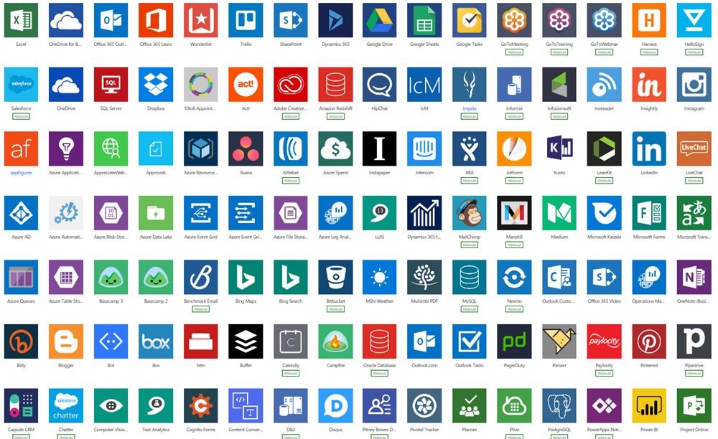
Why external data (Connectors)?
Built-in connectivity to 300+ cloud services, content services, databases, APIs, etc.
Seamless hybrid connectivity to on-premises systems via the on-premises data gateway.
Develop and register custom connectors as a building block for citizen developers.
Connect data silos by using multiple data sources in a single application.

Slide 26
Why internal data (Common Data Service)?
It’s smart
It scales
It’s secure

Slide 27
What is the Common Data Service?
The Common Data Service easily structures
a variety of data and business logic to support
interconnected applications and processes
in a secure and compliant manner

Slide 28
What is the Common Data Service?
The Common Data Service easily structures
a variety of data and business logic to support
interconnected applications and processes
in a secure and compliant manner

Slide 29
What is the Common Data Service?
The Common Data Service easily structures
a variety of data and business logic to support
interconnected applications and processes
in a secure and compliant manner

Slide 30
What is the Common Data Service?
The Common Data Service easily structures
a variety of data and business logic to support
interconnected applications and processes
in a secure and compliant manner

Slide 31
What is the Common Data Service?
The Common Data Service easily structures
a variety of data and business logic to support
interconnected applications and processes
in a secure and compliant manner

Slide 32
What is the Common Data Service?
The Common Data Service easily structures
a variety of data and business logic to support
interconnected applications and processes
in a secure and compliant manner

Slide 33
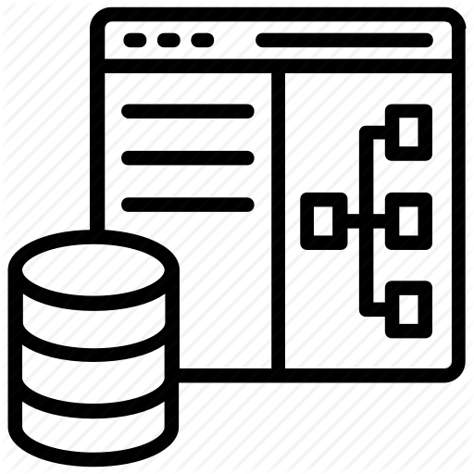
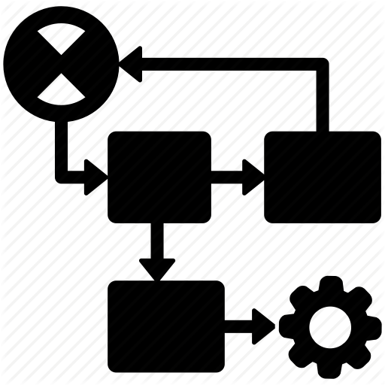


















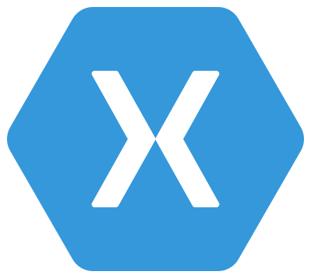

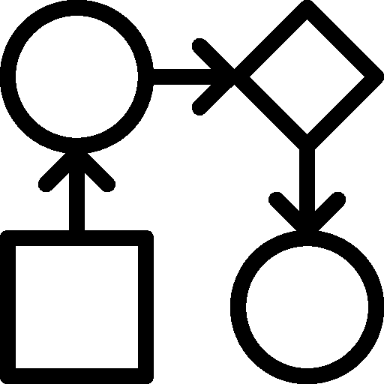
Common Data Service: What’s in the box
Integration
Storage
Relational
databases
Eventing
Data
Catalog
and discovery
Files and
blobs
Logic
Log files
Webhooks
Jobs
Modelling
Security
Reporting
Semi-structured
data
Business
Rules
API
Calculated &
Rollup fields
Authentication
Duplicate
Detection
Data
validation
Search and
Find data
Authorization
Plugins
Data export
Common Data
Model
Auditing
Workflows
Data lake

Slide 34
Power Apps
Power Apps
Application development

Slide 35
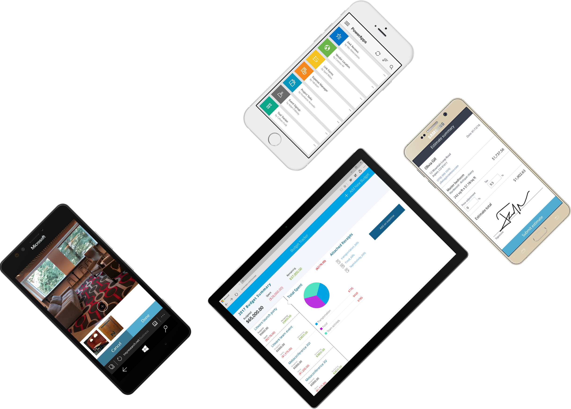
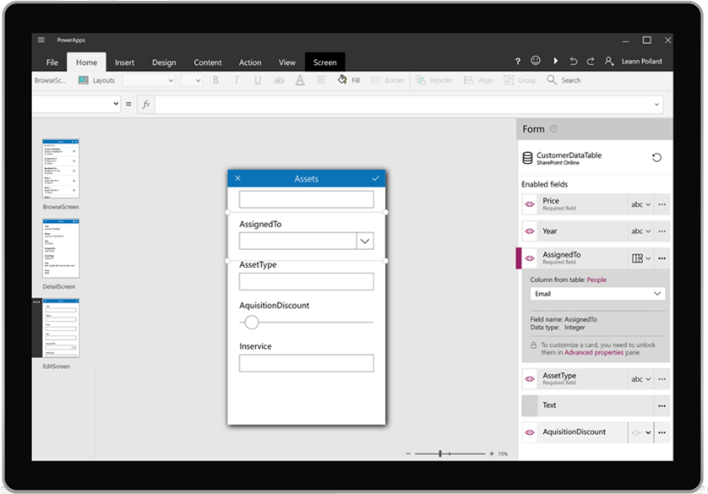














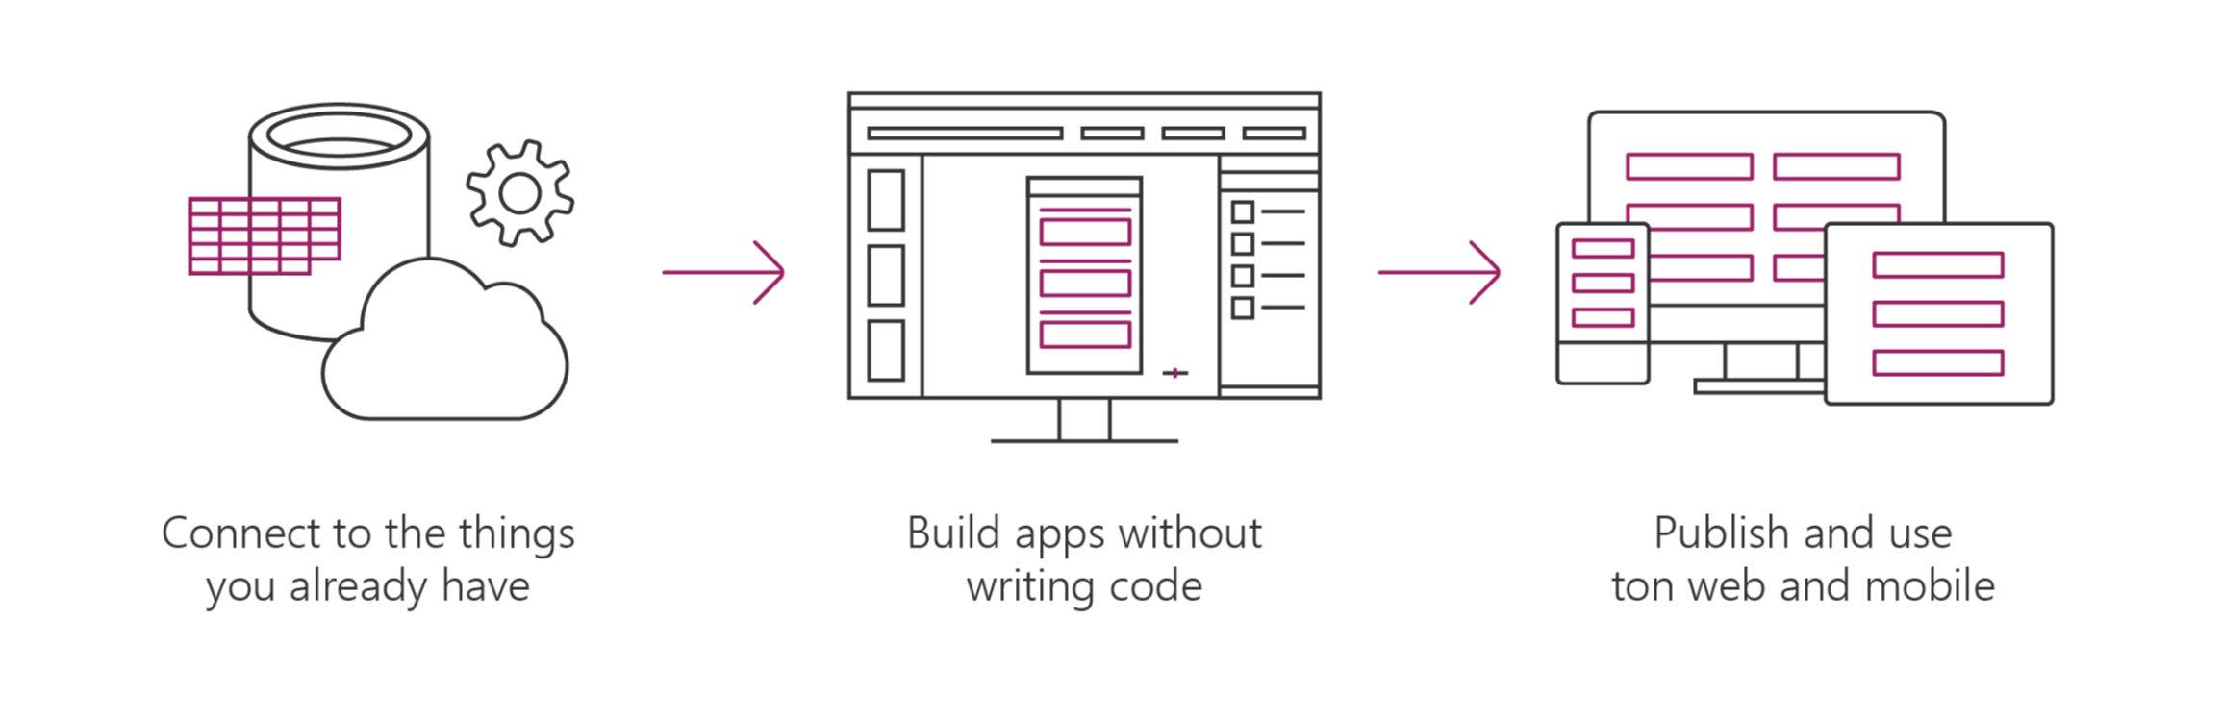











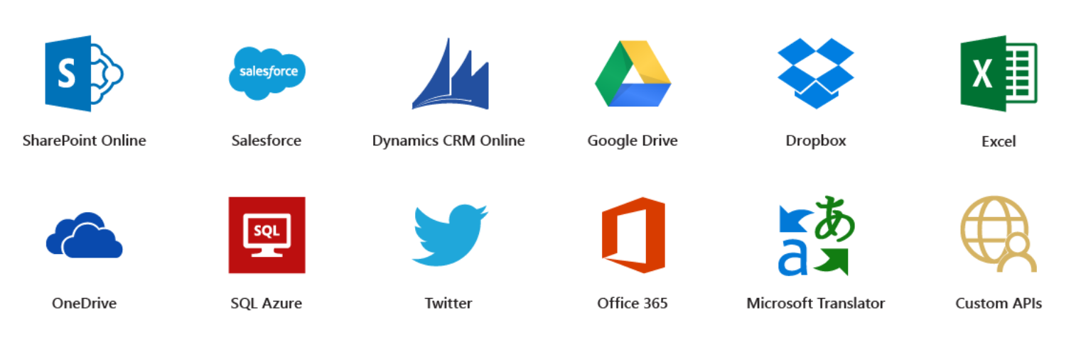




Microsoft PowerApps
Connect to existing systems and data sources
Common Data Platform
Azure Functions & REST services
Build apps, forms, and workflows without writing code
Publish apps instantly for web and mobile
Notes:
Microsoft PowerApps is a service for creating and using custom business apps across platforms

Slide 36
Benefits of PowerApps
Secure Scalable Managed Integrated Compliant
Fast Iterative
Cross-platform
Beautiful Easy

Slide 37
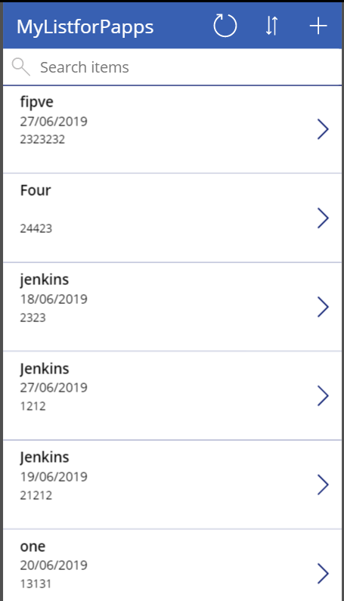
What can I build with PowerApps?
Apps based on data (SharePoint*, SQL, but also DropBox and Google Drive)
Onedimensional, form-based apps
Simple, single-task apps
Microphone, camera, GPS coordinates. Ink and pen support.
Multiple data sources in one app
Multiple screens

Slide 38
86% of the Fortune 500 are using Power Apps

Slide 39
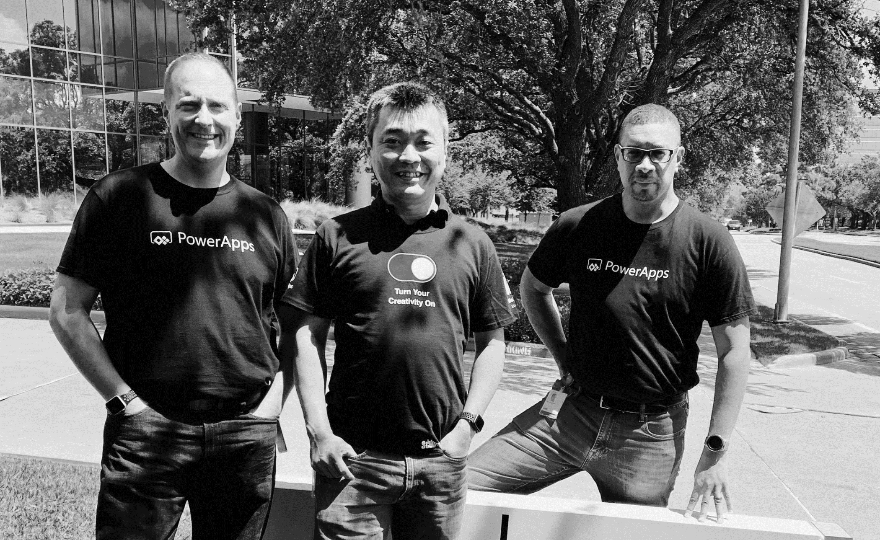
Pro dev
Citizen dev
IT admin
Empower every developer to do more.

Slide 40
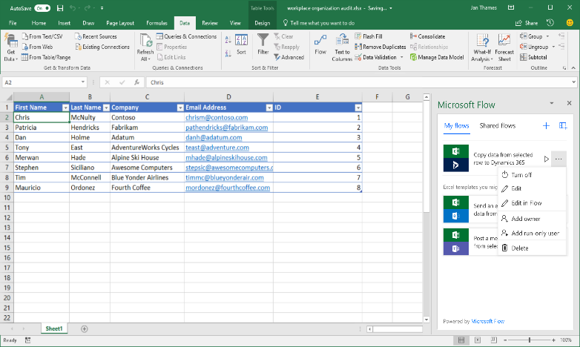
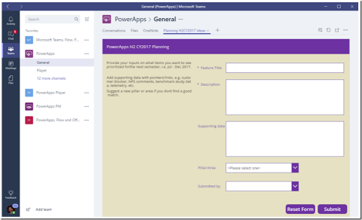
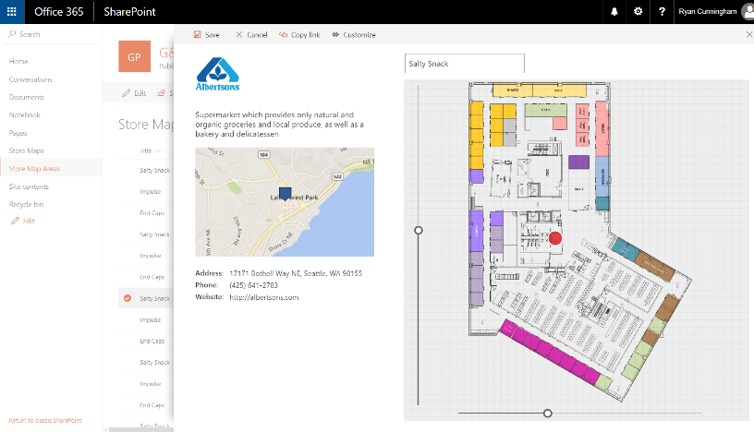
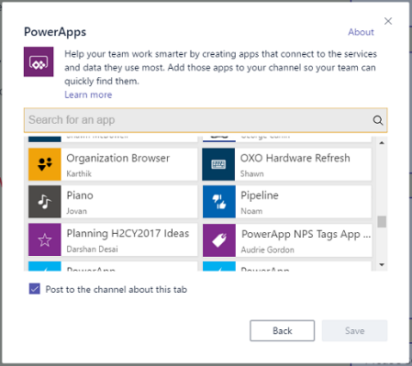
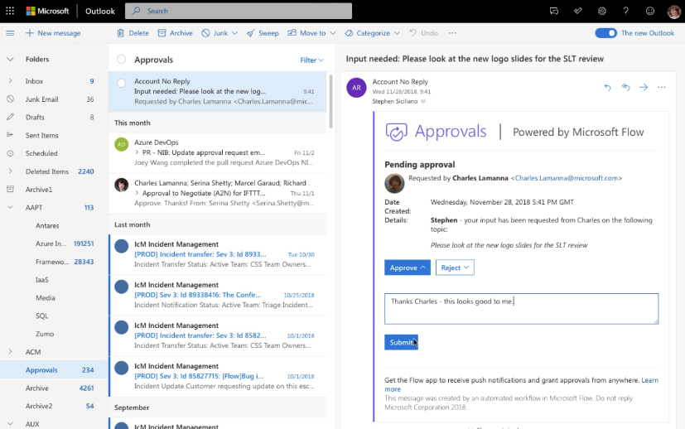
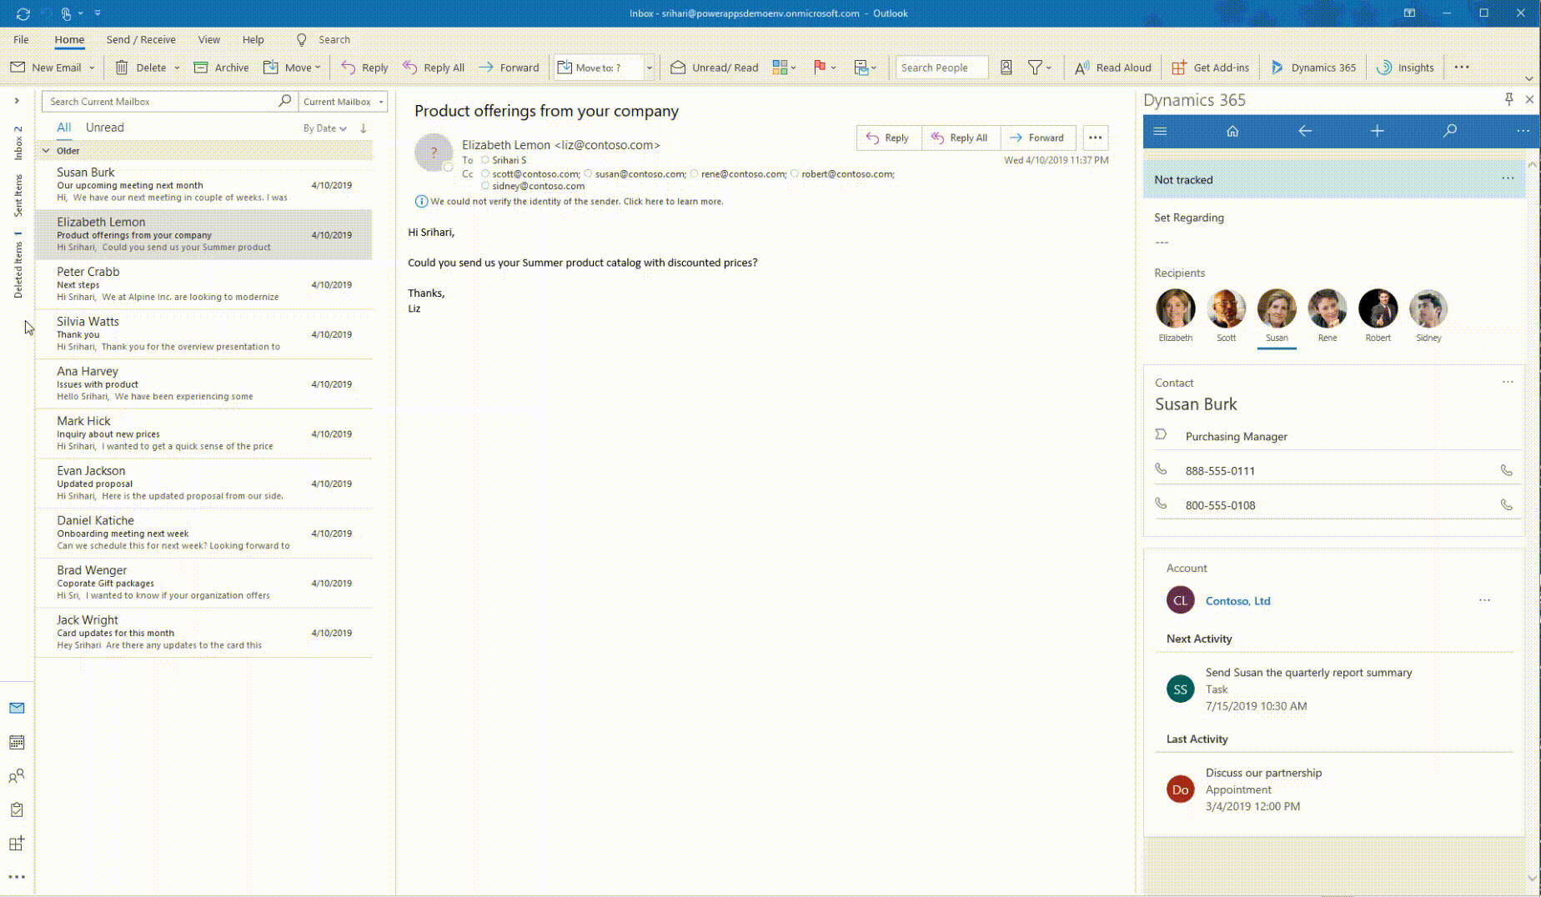
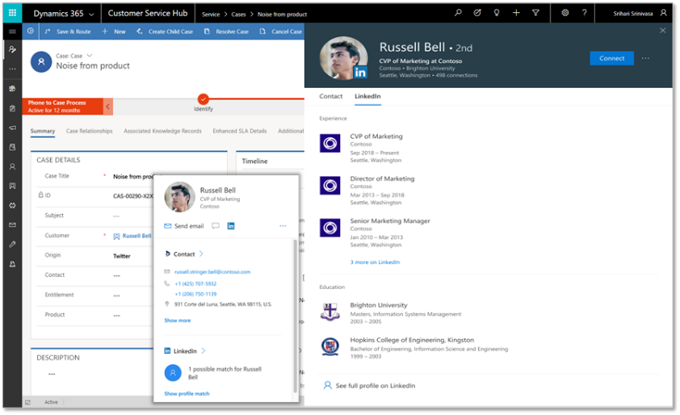
Deeply integrated with Microsoft 365
Customize the experience and automate SharePoint Lists with PowerApps and Flow
Build a PowerApp app from an Excel sheet or automate on an Excel sheet with Flow
Customize a tab with PowerApps, or automate a bot or process with Flow
Enhanced communication with Actionable Messages and Adaptive cards in Flow
Bring data from CDS and PowerApps UX to Outlook with the Mail App (WIn32, OWA and mobile)
Office 365 People Card in PowerApps + Dynamics (incl. LinkedIn info)

Slide 41

Why did we go with PowerApps
We needed a digital onboarding experience with a clear path for customers to follow in self-service planning of their Dynamics 365
Traditional web portals and custom apps are of course great if you know exactly what that path should look like
What we needed the most was the ability to experiment with the elements that should/shouldn’t be included in the onboarding path
Low-code/no-code approach of PowerApps canvas apps significantly lowers our need to commit to any specific feature or idea
Ability to delay developing any tailored UI or integration running on custom code, to the point when you know what you want to automate

Slide 42

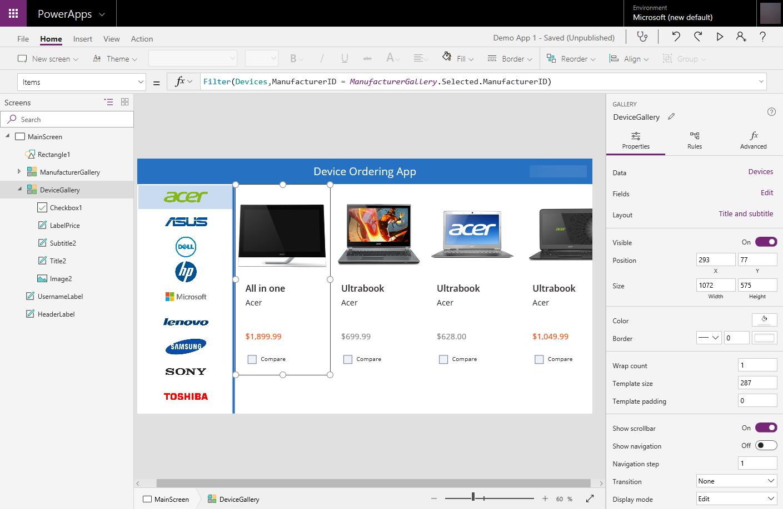


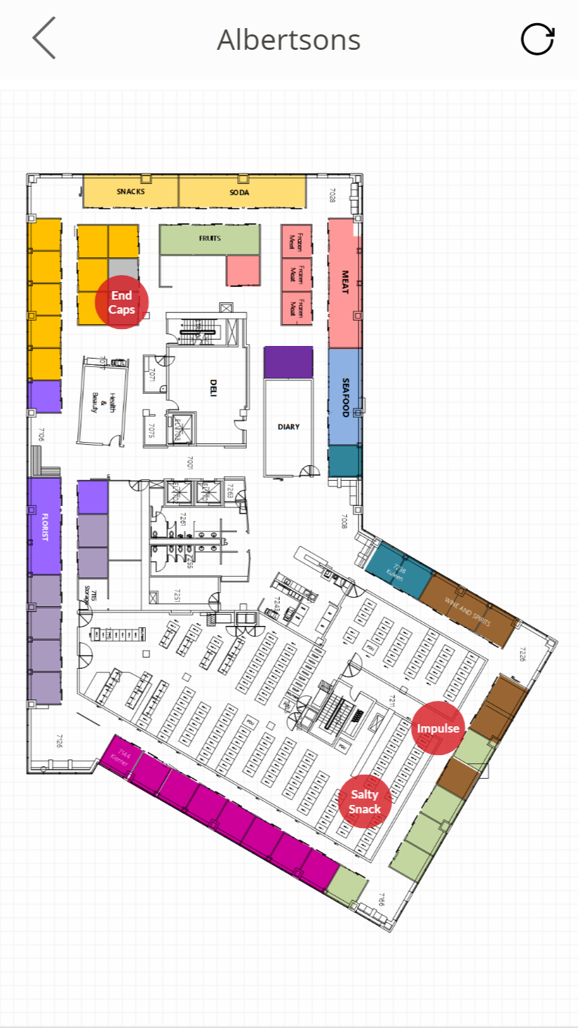
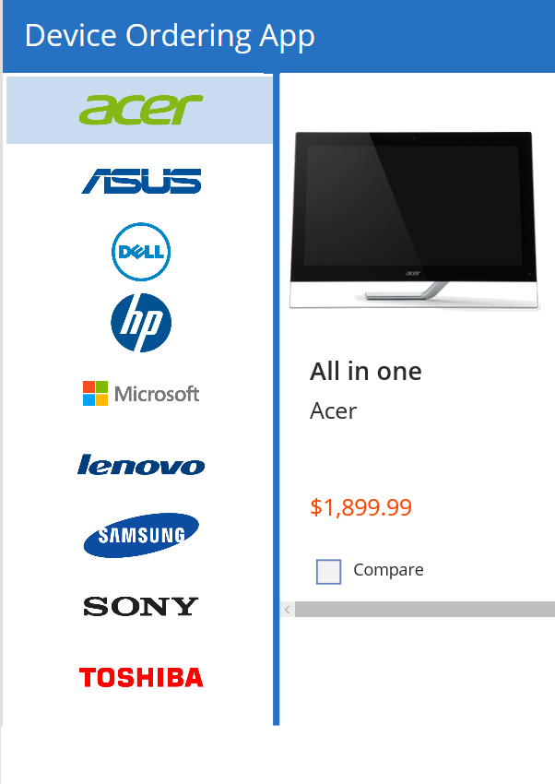
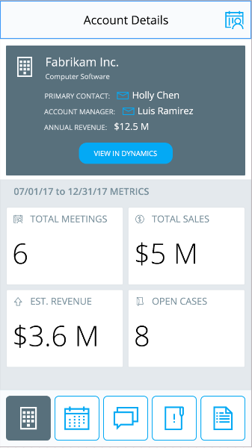

Power Apps: a low-code approach to building apps
Easily build apps with a full featured low-code / no-code platform
Connect to your existing data with 300+ pre-built connectors and custom connectors
Store your data in the Common Data Service
Integrated with Office 365, Azure, Dynamics 365, and Power BI
Strong enterprise governance & security
Pro-dev extensibility

Slide 43
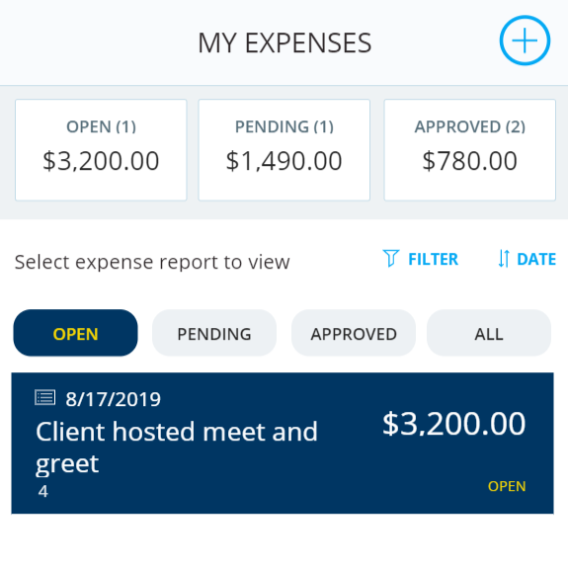
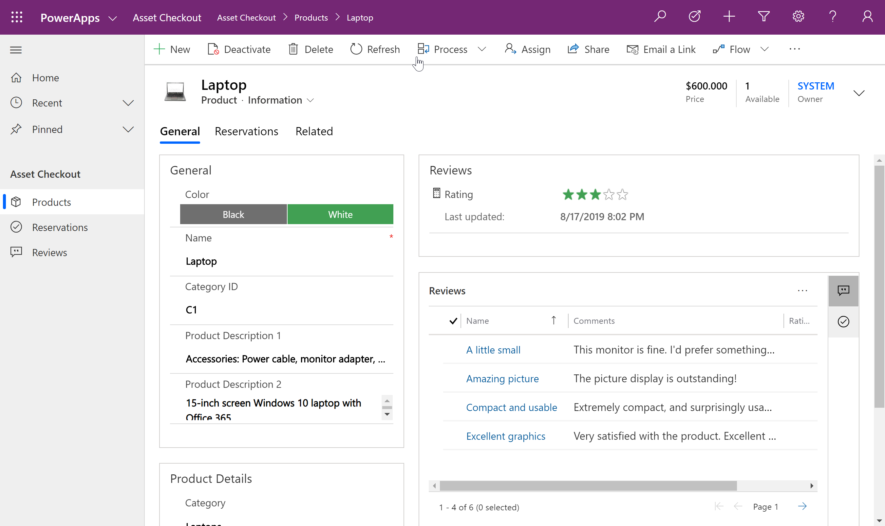
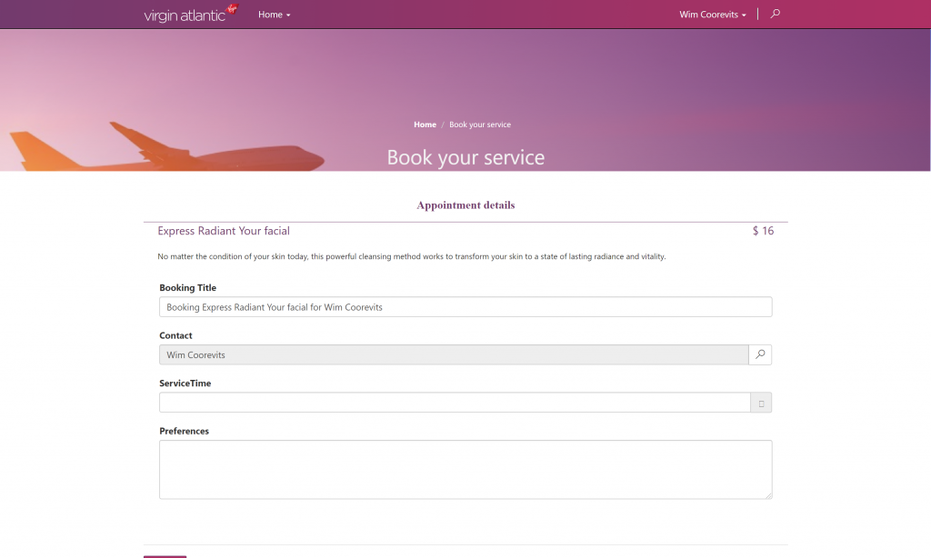
Types of Power Apps
Canvas Apps
Model Driven Apps
Portals

Slide 44

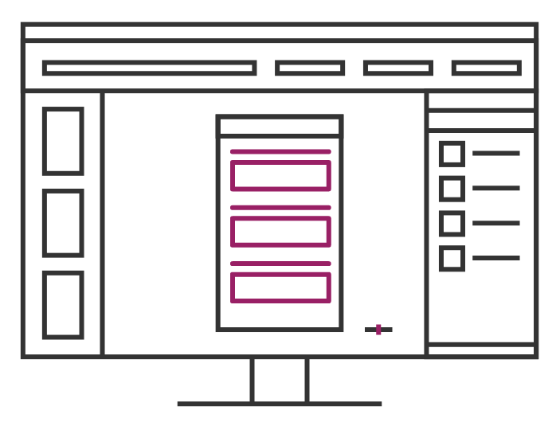
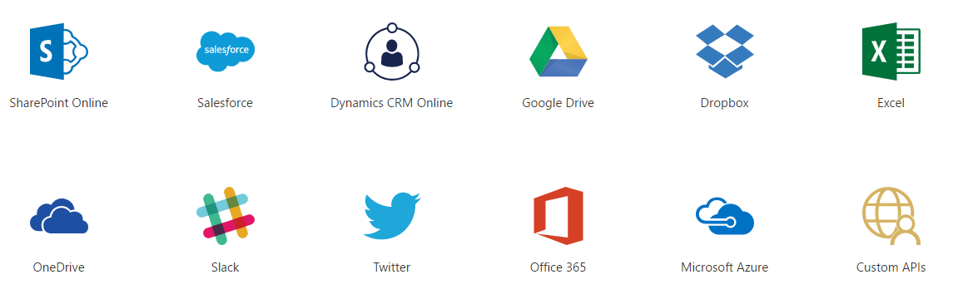
Data Sources and connections

Slide 45
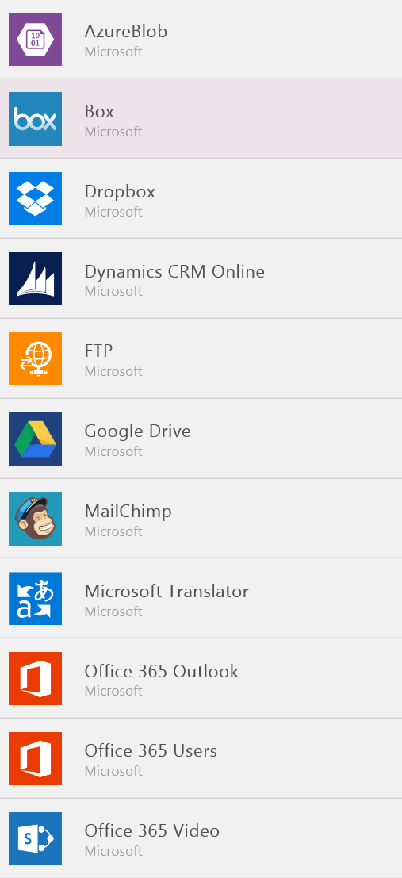
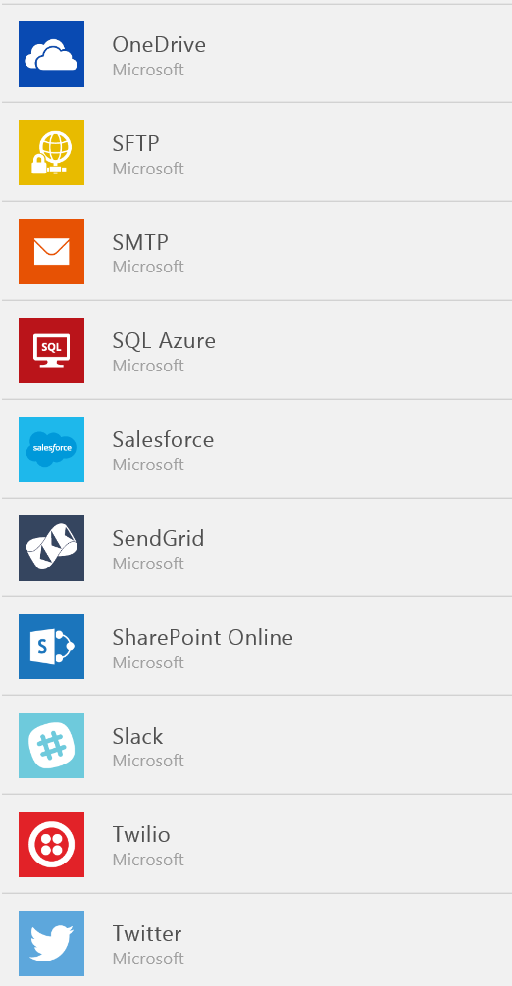
Data Sources…
SaaS Data Sources
Excel on OneDrive
Excel on Dropbox
Excel on Google Drive
Office 365
SharePoint Online Lists
Google Sheets
Sales force
Dynamics CRM

Slide 46
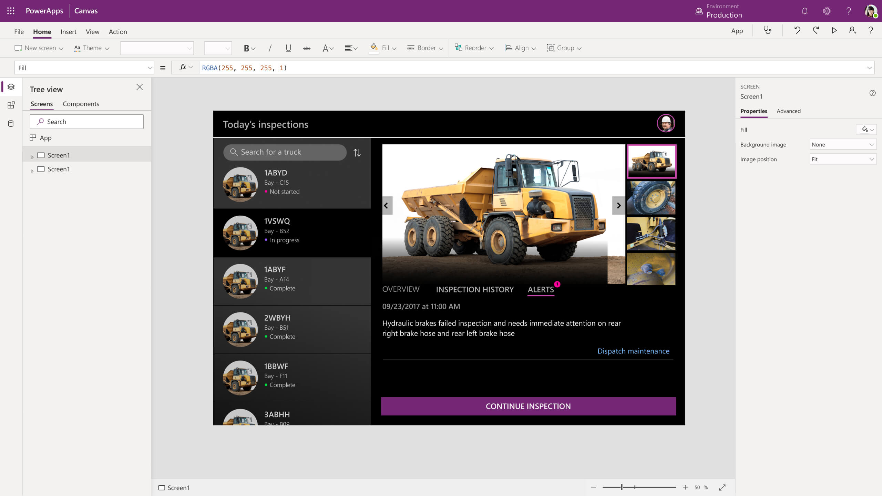
Power Apps
Turn ideas into organizational solutions by enabling everyone to build custom apps that solve business challenges.

Slide 47
Power BI
Power BI
Business analytics

Slide 48

Power BI: experience your data Any data, any way, anywhere
Web
Mobile
Excel
Cloud data
Power BI
Embedded
HoloLens
On-premises data
“……”

Slide 49
1
2
3
The 5x5 Principle
5 Seconds to Signup
5 Minutes to Wow

Slide 50
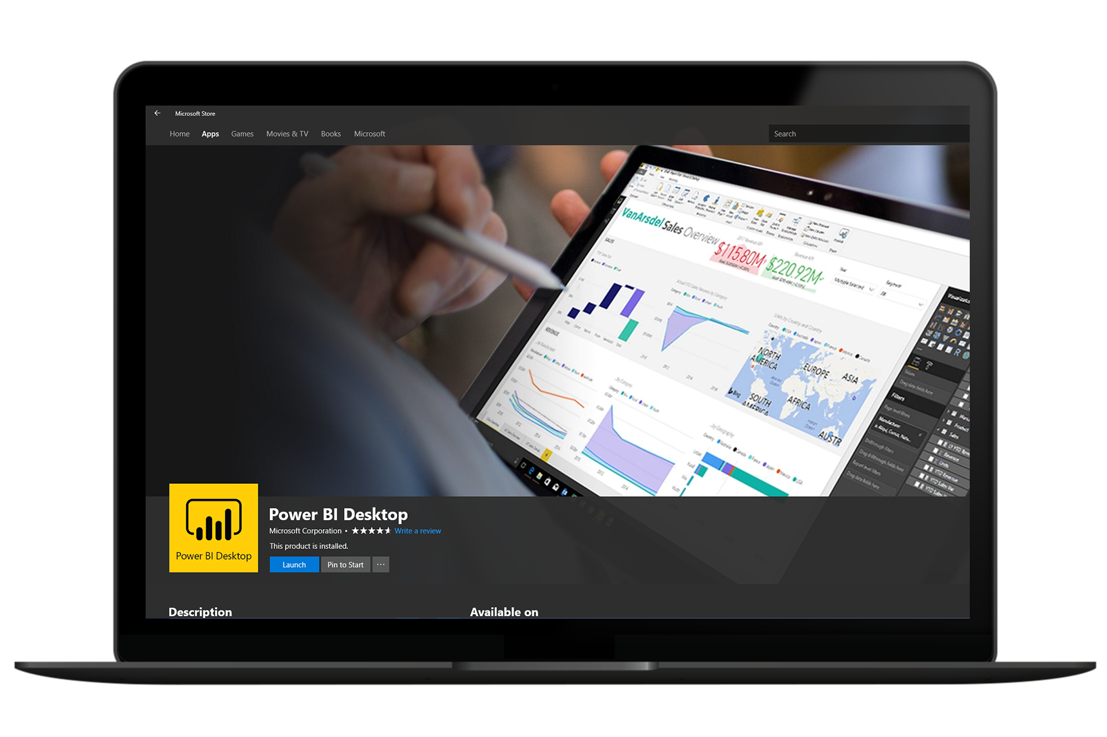
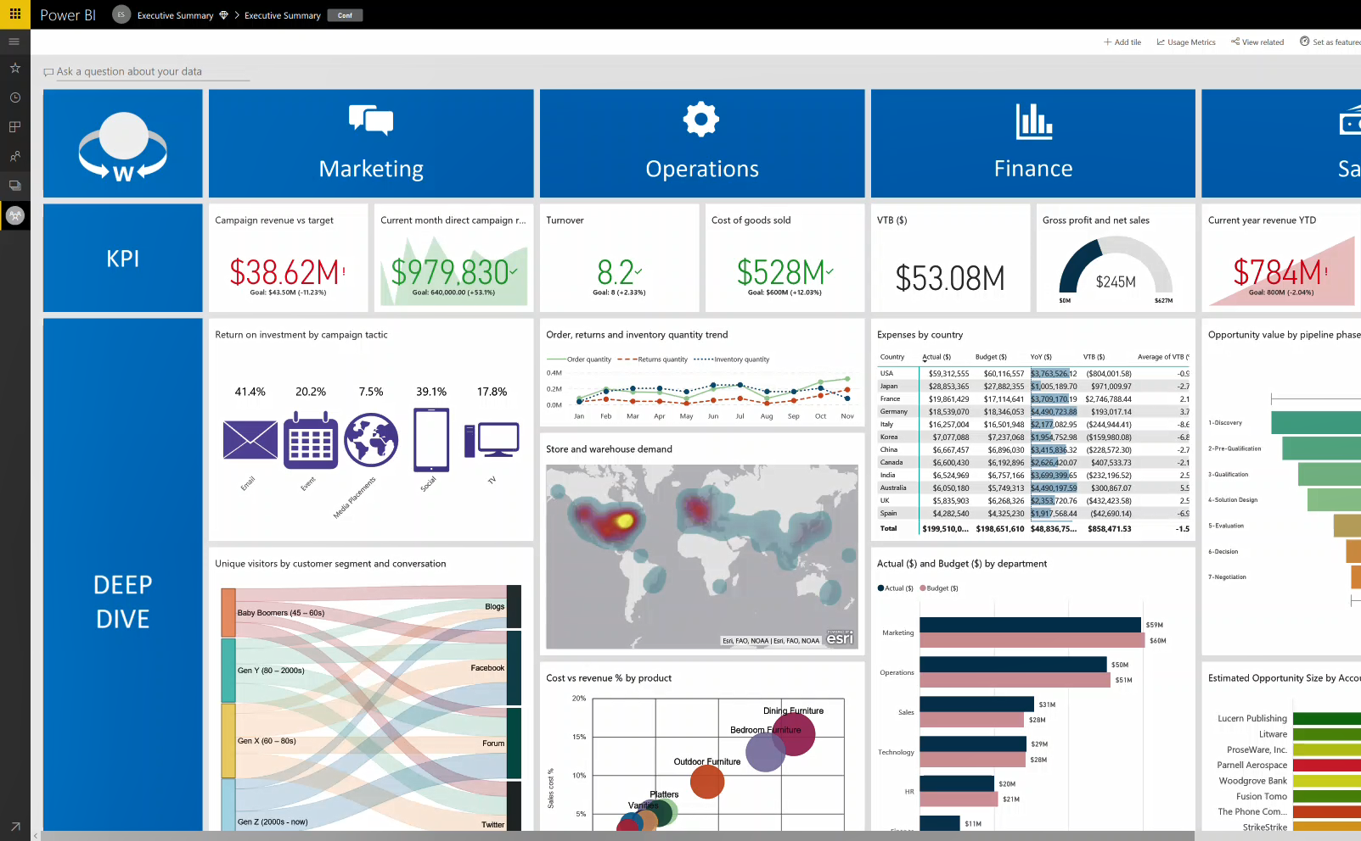
1
2
3
Get started
in minutes

Slide 51



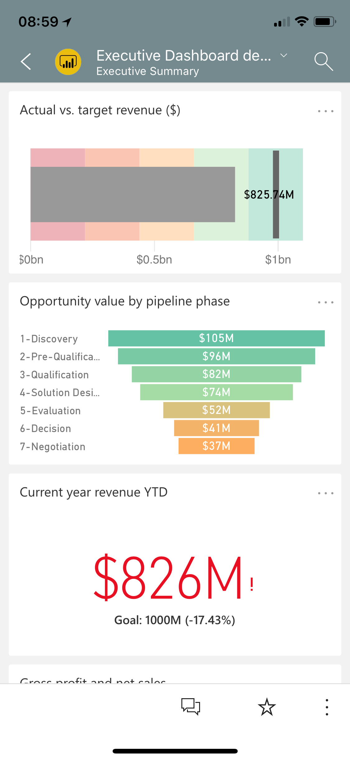
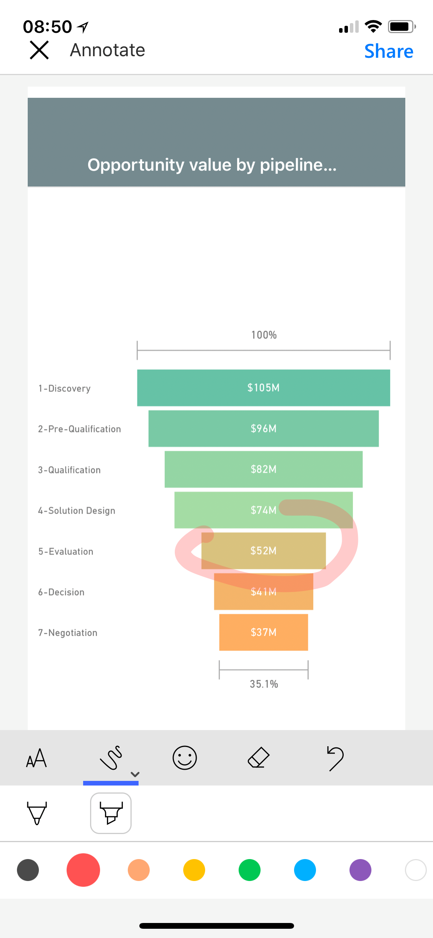
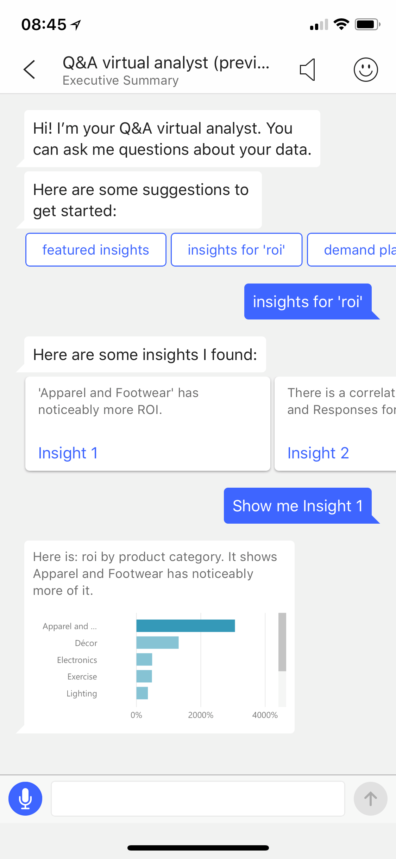
1
2
3
Stay connected to your data on the go

Slide 52
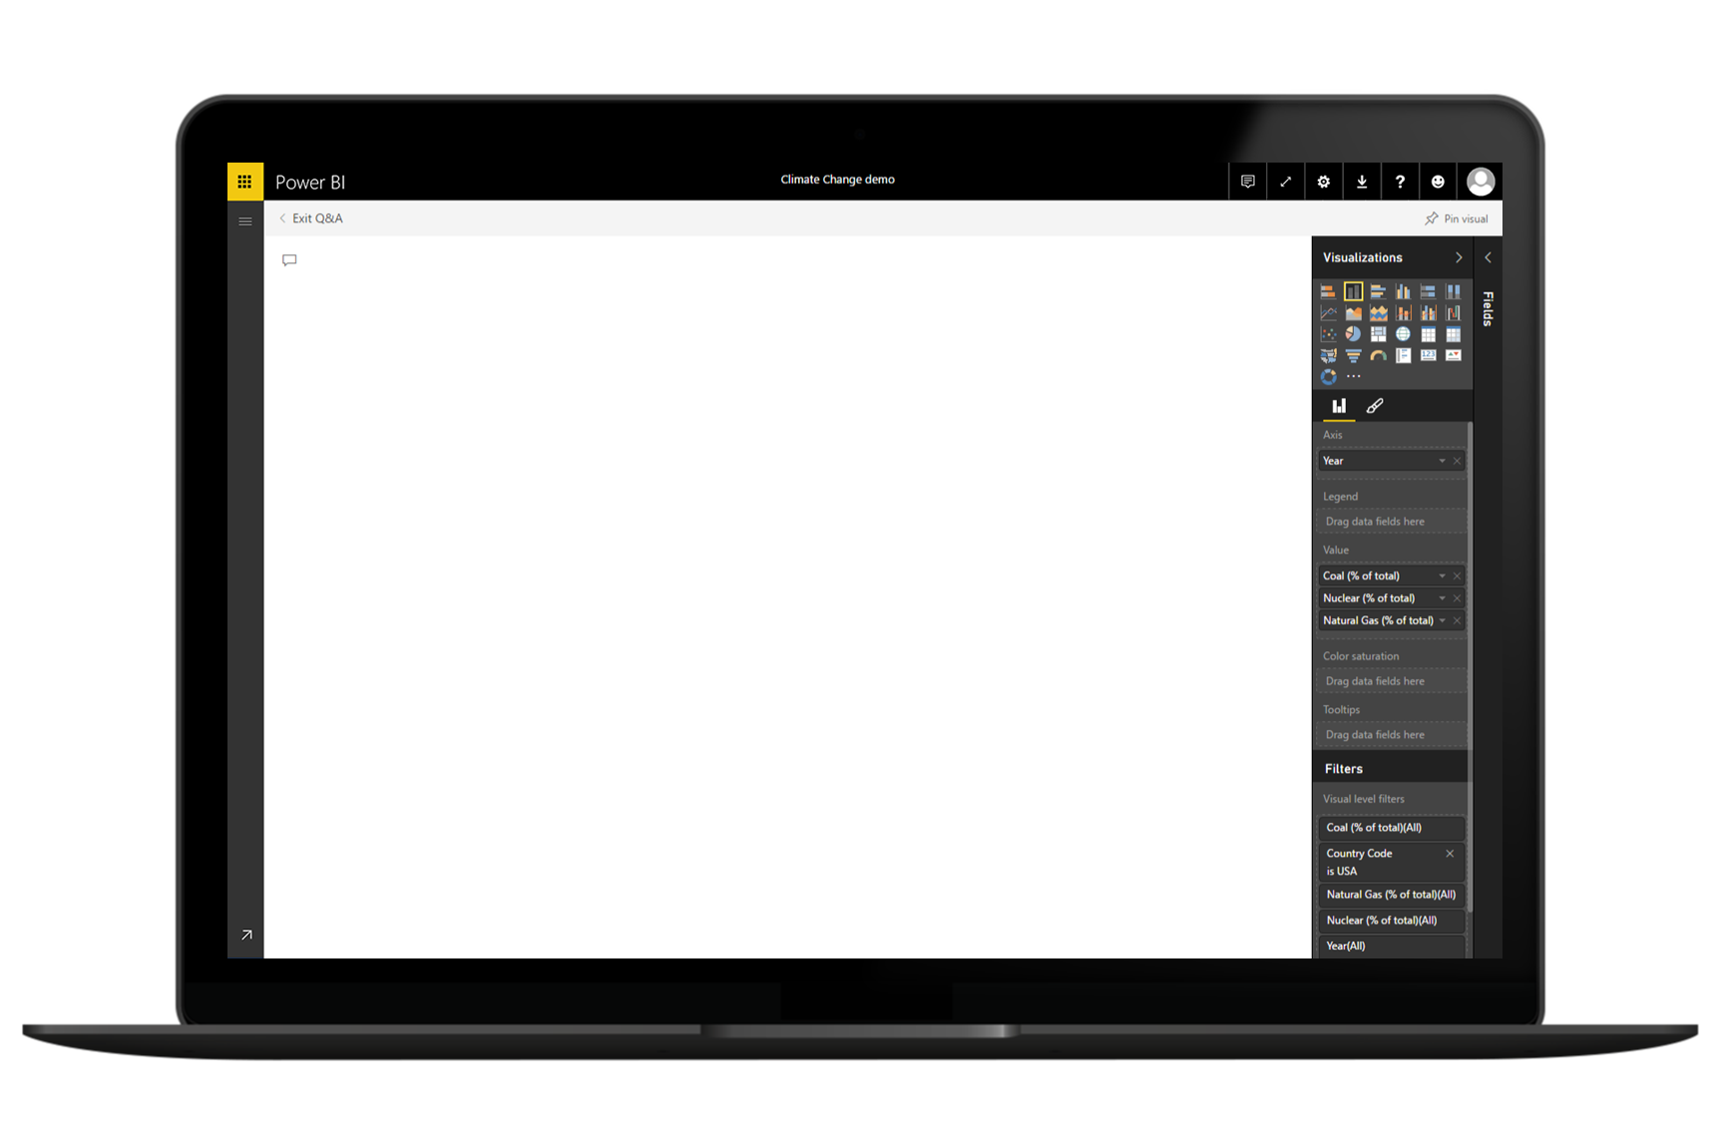
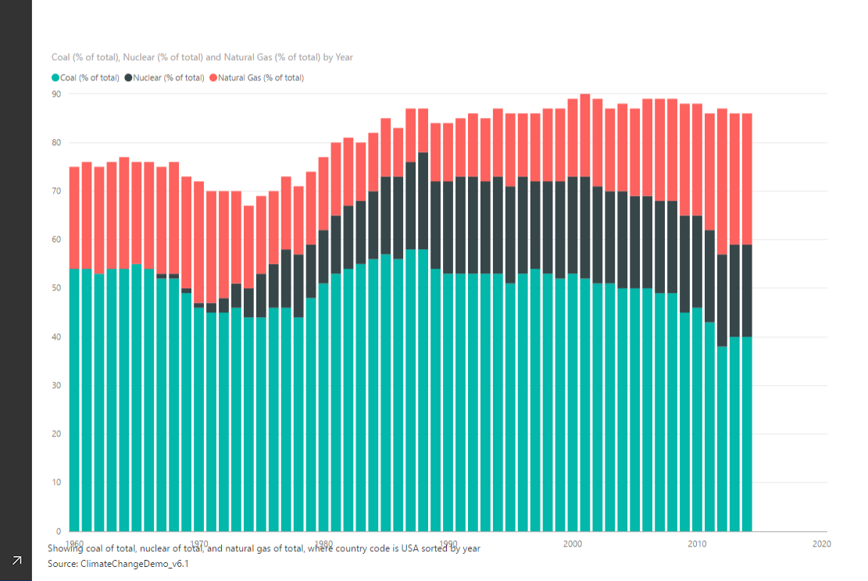
1
2
3
Electricity from coal, nuclear, gas per year in USA
Ask questions, get answers

Slide 53
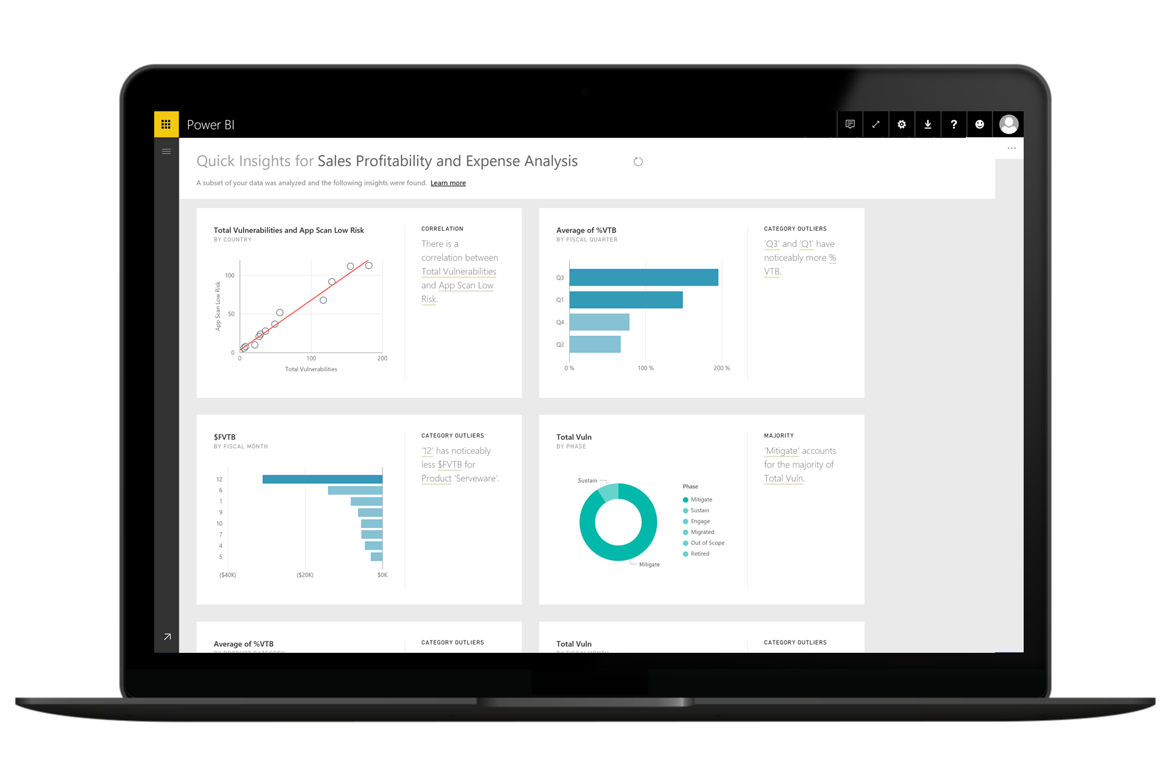
1
2
3
Automatically discover insights from your data

Slide 54

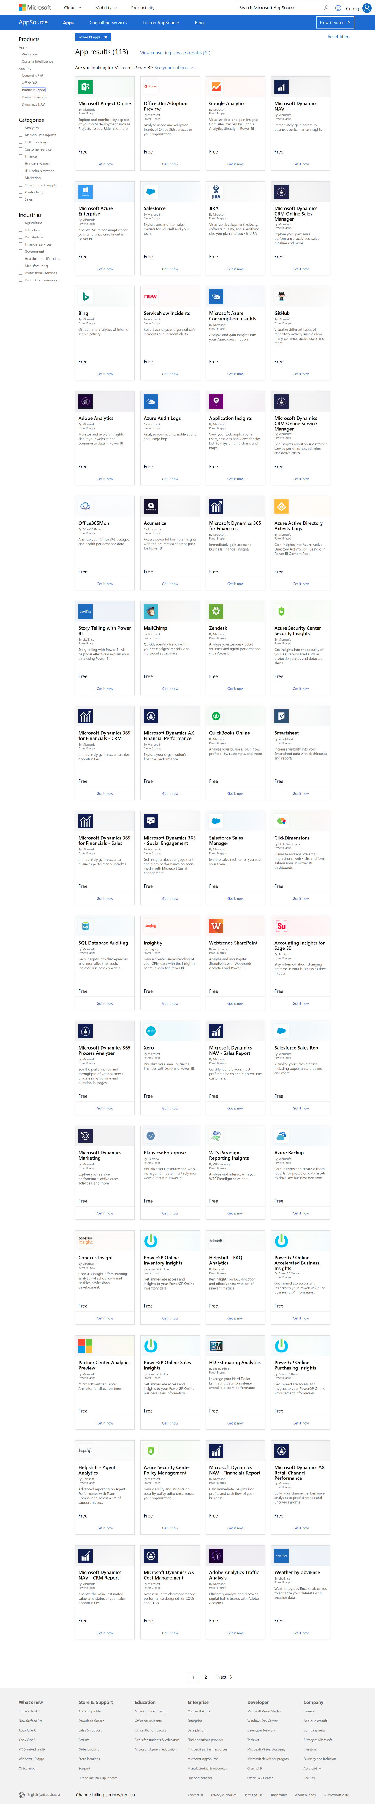
1
2
3
Accelerated deployment with pre-prepared content

Slide 55
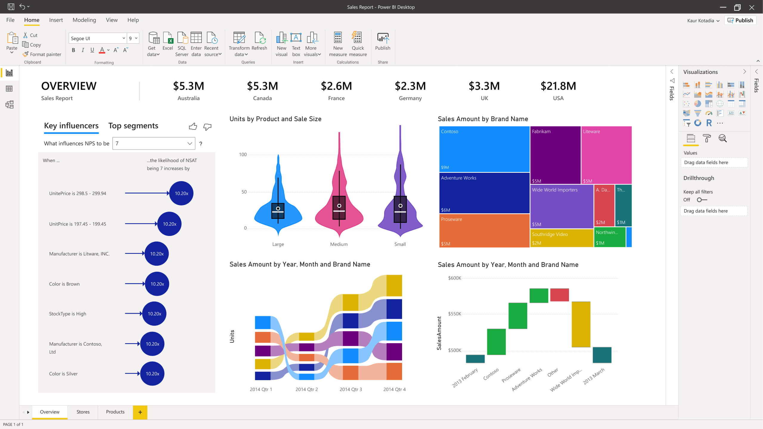
Power BI
Make informed, confident business decisions by putting data-driven insights into everyone’s hands.

Slide 56
Power Automate
Power Automate
Process automation

Slide 57





What is Power Automate?

Slide 58
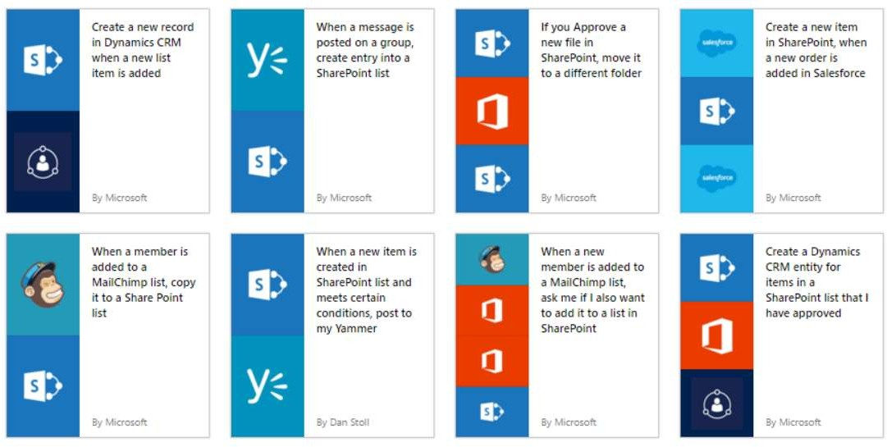
GET STARTED
https://flow.microsoft.com
Source: Microsoft

Slide 59
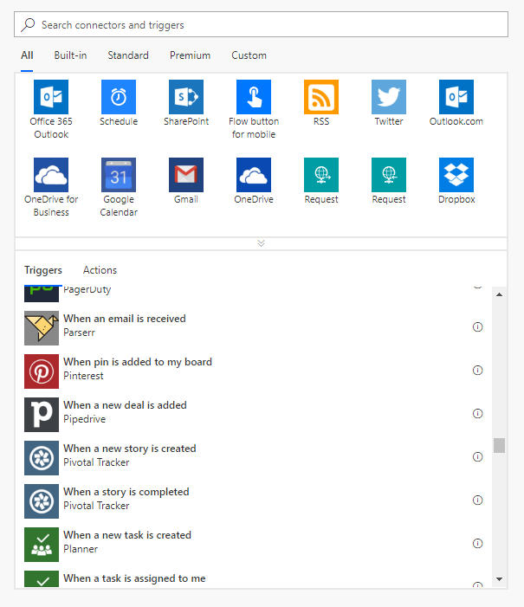
Types of Flows
Scheduled flows
Automated flows
Instant flows
Business process flows

Slide 60
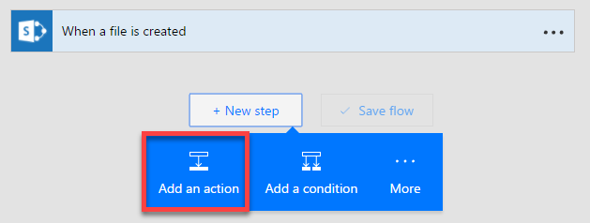
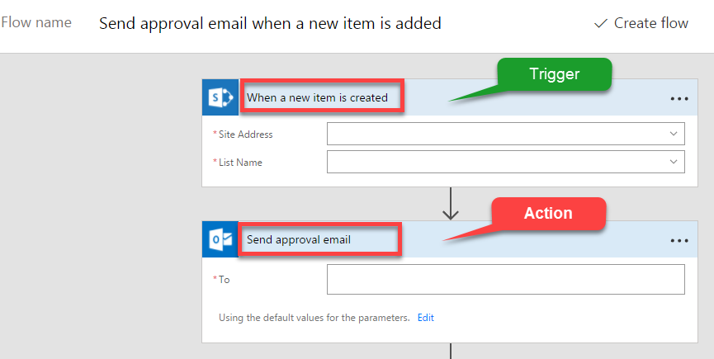
Flow Components
Three major components
Triggers
Actions
Conditions

Slide 61
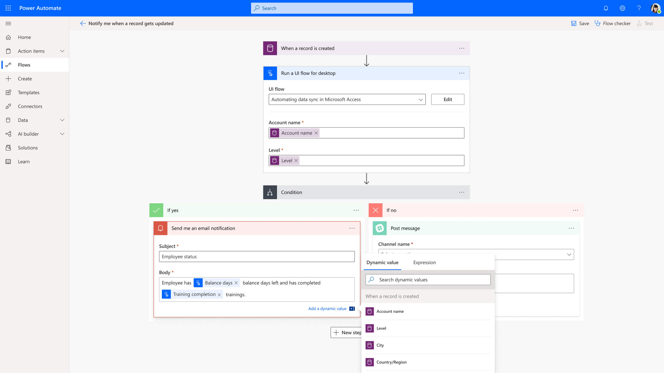
Power Automate
Boost business productivity to get more done by giving everyone the ability to automate organisational processes.

Slide 62
Power Virtual Agents
Power Virtual Agents
Intelligent virtual agents

Slide 63
Empower your people to drive more business value through easy to create natural, conversational AI
Power Virtual Agents
Intelligent virtual agents

Slide 64
Complex challenges
66%
90%
59%
try to use self-service first rather than contacting an agent for assistance¹
of customers expect consistency and continuity across channels²
of channels are managed in silos³
Global State of Customer Service, Microsoft
Aberdeen: Empowered Customers Demand a Seamless Experience
Dimension Data: 2017 Global Customer Experience Benchmarking Report

Slide 65
Chat bots can help, but…
Bots are hard to create and expensive to maintain
There is friction between the subject matter experts with answers - and the developers and scientists who create bots
Bots aren’t useful unless they can integrate with the backend and provide personalized answers
Global State of Customer Service, Microsoft
Aberdeen: Empowered Customers Demand a Seamless Experience
Dimension Data: 2017 Global Customer Experience Benchmarking Report

Slide 66


Our vision: Power Virtual Agents
ENGAGE NATURALLY
Engage with your customers and employees conversationally. Resolve routine issues easily, freeing up staff to focus on complex matters
DEMOCRATIZE AI
Empower your subject matter experts to easily create powerful bots using a guided, no-code graphical interface. No need for developers or data scientists.
CONTINOUSLY IMPROVE
Point the AI to your website, and automatically build topics to get started with a few clicks. As the bot gets used, powerful metrics and insights help tell you what topics to build next
Empower every organization to easily provide delightful, natural interactions with their customers and improve engagement and outcomes
TAKE ACTION
Connect to your backend systems with a few clicks using the hundreds of connectors that come with Power Platform – or call APIs and custom workflows using Power Automate. The full power of the Microsoft Bot Framework is only a few clicks away.

Slide 67
Power Virtual Agents is Designed For Everyone The chatbot service that enhances everyone’s experience
Your Customers
Subject Matter Experts
IT Admin/Dev

Slide 68
A Robust Virtual Agent Platform
Easily build powerful conversations
Create personalized customer experiences
Limitless extensibility with Bot Framework Skills
^{preview}

Slide 69
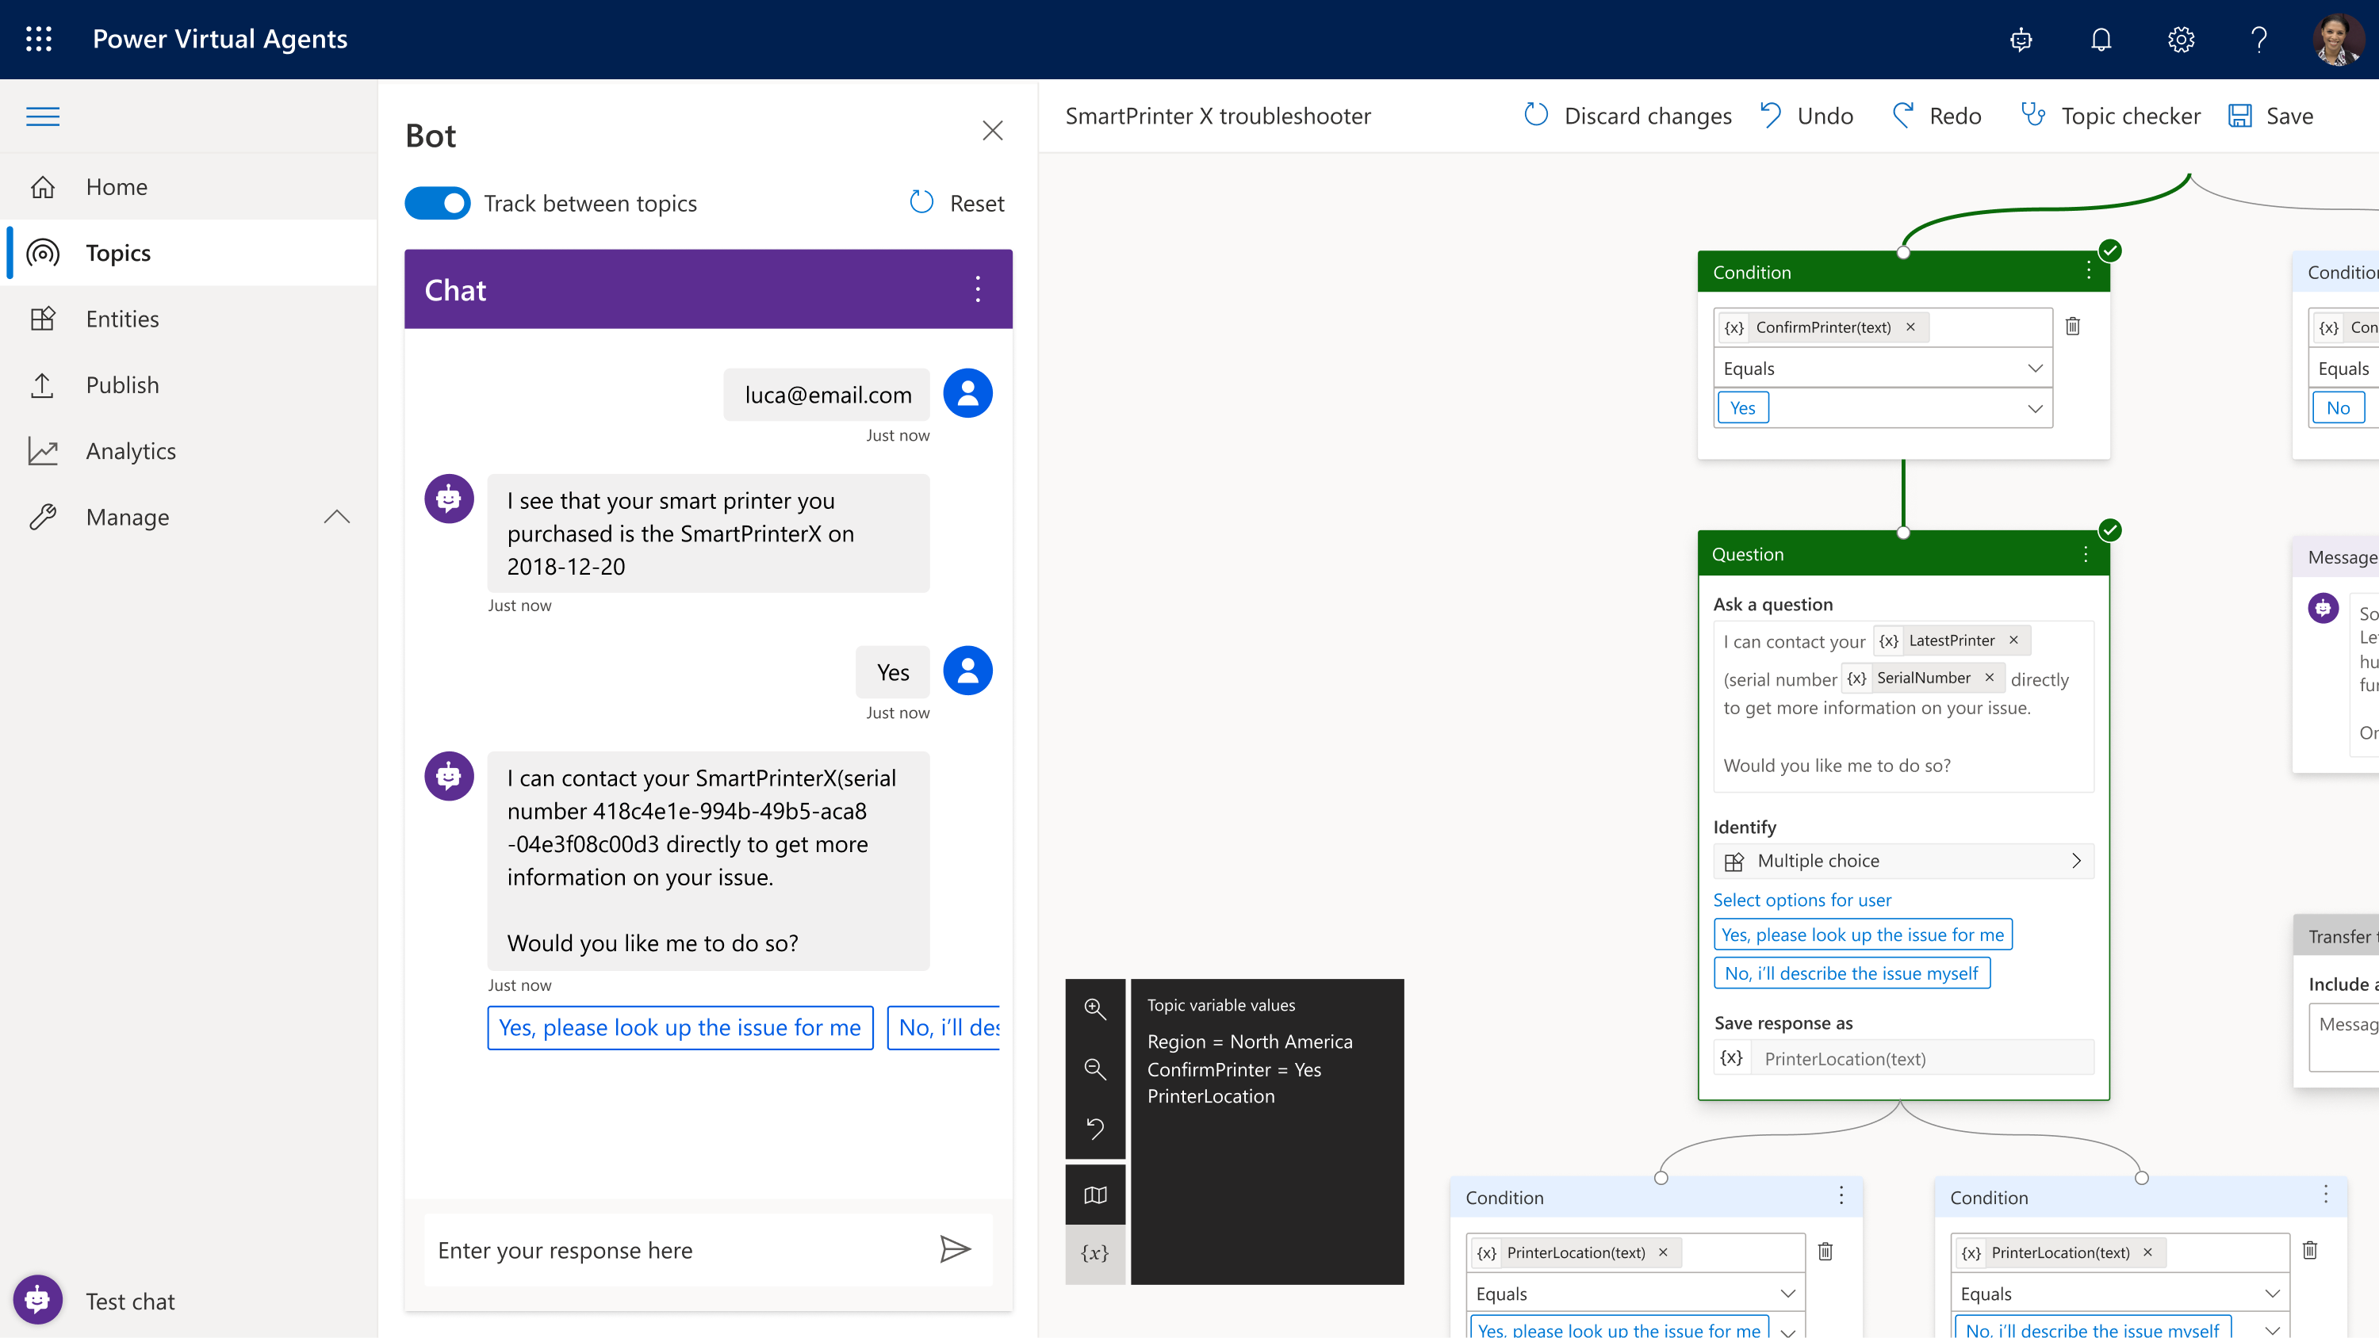
Making Bots Easy
Simple, graphical bot creation
Easily test and maintain bots through a simple, easy to use graphical interface
Extract information from user responses
Recognize, extract, and act on common entities in a user’s responses. For example, colors, currencies, ages, dates and times. Or create your own custom entities, e.g. model numbers
Remember user responses
Store user information for use later in variables and use them to branch or create personalized conversations

Slide 70

Get Started Quickly
Learn from your website
Just point the bot to your website, and it will extract common questions, FAQs and pre-build topics for you – so you can be up and running in minutes - out of the box.

Slide 71

Avoid Repetitive Conversations
Slot-filling capabilities
The bot doesn’t follow the dialog script blindly. It intelligently uses all the information it has to decide when to ask a question and when to skip them.
For example, if the user provided information earlier in the conversation, the bot will remember it and skip asking about it again

Slide 72

Converse everywhere
Use bots wherever you need them:
Configure and deploy to multiple channels
Easily embed your bot wherever your organization engages with customers: websites, mobile apps, Facebook, Teams or any of the dozens of channels supported by Azure Bot Service
Deploy to demo sites with a single click
Test and gain feedback by deploying your bot to a demo website and sharing it internally with colleagues, before embedding it to your own website when ready

Slide 73

Easily make your bots better
Easily see what’s working – and what to improve
Analyze bot / customer conversations to better understand how specific topics are performing, what’s impacting your CSAT, and identify where there is room for improvement
Quickly figure out what to build next
Easily see which conversations are going to human agents and determine which topics to teach your bot next

Slide 74

Power Virtual Agents
Easily build chatbots to engage conversationally with your customers and employees—no coding required.

Slide 75


Setup Environment

Slide 76
Customer Stories

Slide 77



Building apps that save money
A small team at G&J Pepsi with no previous app-development experience created auditing apps that saved the company $500,000
https://customers.microsoft.com/en-us/story/gj-pepsi-consumer-goods-powerapps

Slide 78



Customer: Miami HEAT
Industry: Media and Entertainment
Size: 50–999 employees
Country: United States
Products and services: Microsoft Dynamics 365 Sales
Microsoft Power BI
Microsoft Azure
Read full story here
“After we implemented the data warehouse and Dynamics 365, we had a 30 percent year-over-year increase in our season ticket sales with essentially the same team on the floor.”
—Matthew Jafarian, Executive Vice President of Business Strategy, Miami HEAT
The Miami HEAT is always trying to make fan experiences even better. In the past, inefficient data collection and analysis sometimes delayed decision-making and made it hard to understand fan needs and expectations.
The HEAT adopted Microsoft Dynamics 365, Power BI, and Azure. The HEAT now aggregates 360-degree fan profiles to personalize fan communications, and it uses Adobe Marketing Cloud to harness the profiles to personalize digital experiences.
With better views into its data, the HEAT streamlined fan experiences networking. With Power BI insights, the organization saved approximately $1 million with simple operational changes, and 360-degree profiles in Dynamics 365 have helped drive a 30 percent increase in season ticket sales.

Slide 79



Boosting customer satisfaction
Virgin Atlantic creates custom-built mobile apps to continually improve the start-to-finish travel experiences of 5 million passengers a year.
https://customers.microsoft.com/en-US/story/virgin-atlantic-travel-and-transportation-power-apps

Slide 80




Vehicle glass repair provider digitizes processes and increases productivity with self-developed apps
Harmony to update image and add published link
Belron® is the worldwide leader in vehicle glass repair and replacement through brands such as Autoglass®, Carglass®, and Safelite®. To streamline previously manual and time-consuming processes, the company adopted Microsoft PowerApps, part of the full Microsoft Business Application Platform stack. It now uses more than 40 apps, all developed in-house by just one employee with no programming skills. Used broadly across the business, from HR to field service reps, the apps help the company improve efficiency, save money, and make it easier for staff to operate effectively.
Microsoft PowerApps
Microsoft Flow
Microsoft Power BI
Common Data Service for Apps
Microsoft Office 365
26,300 employees
Consumer Goods
United Kingdom
Notes:
https://customers.microsoft.com/en-us/story/belron-autoglass-consumer-goods-powerapps

Slide 81





Technical Helpdesk App
Leadership App
Fleet Checks App
PowerApps
Microsoft Flow
Microsoft Power BI
Common Data Service
Microsoft Office 365
26,300 global employees
Consumer Goods
United Kingdom
N/A
Achieve more together
Anywhere it matters
Simplified for business
Notes:
https://customers.microsoft.com/en-us/story/belron-autoglass-consumer-goods-powerapps

Slide 82


Customer: French National Railway Company (SNCF)
Industry: Travel and Transportation
Size: 270,000 employees
Country: France
Products and services: Microsoft Flow Microsoft PowerApps Microsoft Power BI Microsoft SharePoint Online
Read full story here
“When we implemented and explained the potential of these digital tools, we empowered each employee to innovate and share their ideas on how to improve their work on a daily basis.”
—Magali Dupin, Continuous Improvement and Communication Manager, SNCF
As part of ongoing efforts to improve business productivity, French national railway company SNCF launched an initiative called “Digital for All” to better include employees in digital solution development.
SNCF adopted Microsoft PowerApps, Power BI, and Microsoft Flow, then used internal and online training to foster employee adoption, cultivate internal app experts, and create new, innovative apps that digitize business and maintenance processes.
Tens of thousands of SNCF employees now use more than 150 apps to help simplify and streamline tasks. And the company uses real-time analysis in Power BI to reduce errors, increase reliability, and improve production processes.

Slide 83

Demo
Power Platform Account Setup

Slide 84
Customer Stories
Questions

Slide 86
Day 2 - Power Automate Introduction

Slide 87
Jenkins NS
Modern Workplace Solution Architect | Consultant
Microsoft Teams, Power Platform and SPFx Specialist
International Speaker | Blogger | Trainer
SPS Bangalore Organizer
aOS Ambassador
jenkinsns@gmail.com
in/jenkinsns
@jenkinsns
http://www.jenkinsblogs.com
jenkinsns
https://www.facebook.com/spfxinfo/
https://www.facebook.com/msteamsinfo

